Slide 1
The Atomic Nucleus and Radioactivity

Slide 2
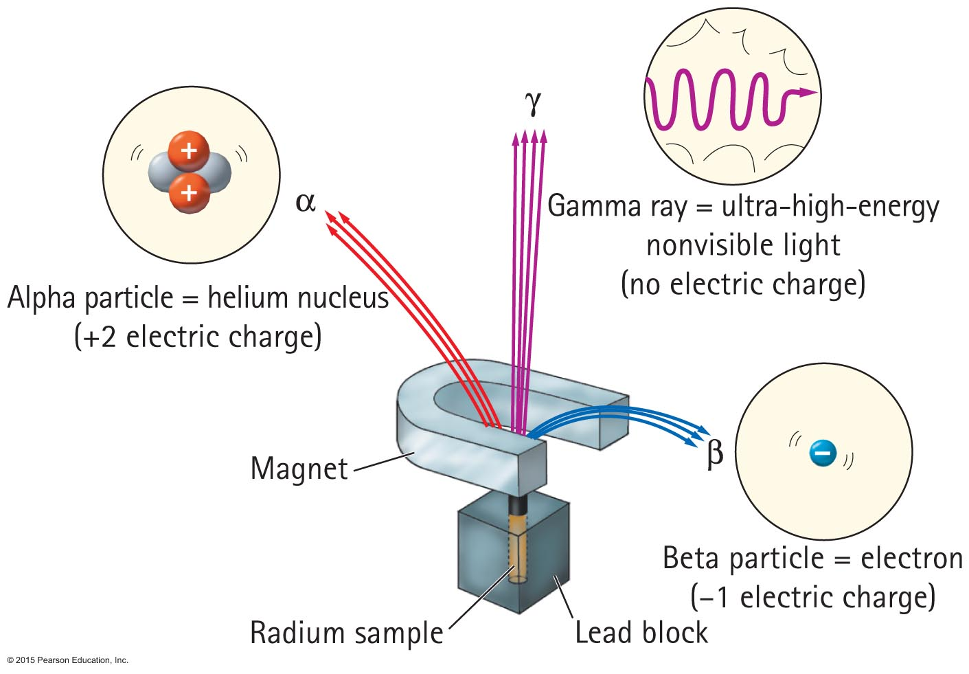
Alpha, Beta, and Gamma Rays
Radioactive elements emit three distinct types of radiation:
𝜶 —alpha: positively charged (helium nuclei)
β —beta: negatively charged (electrons)
𝛄 —gamma (electromagnetic radiation)

Slide 3
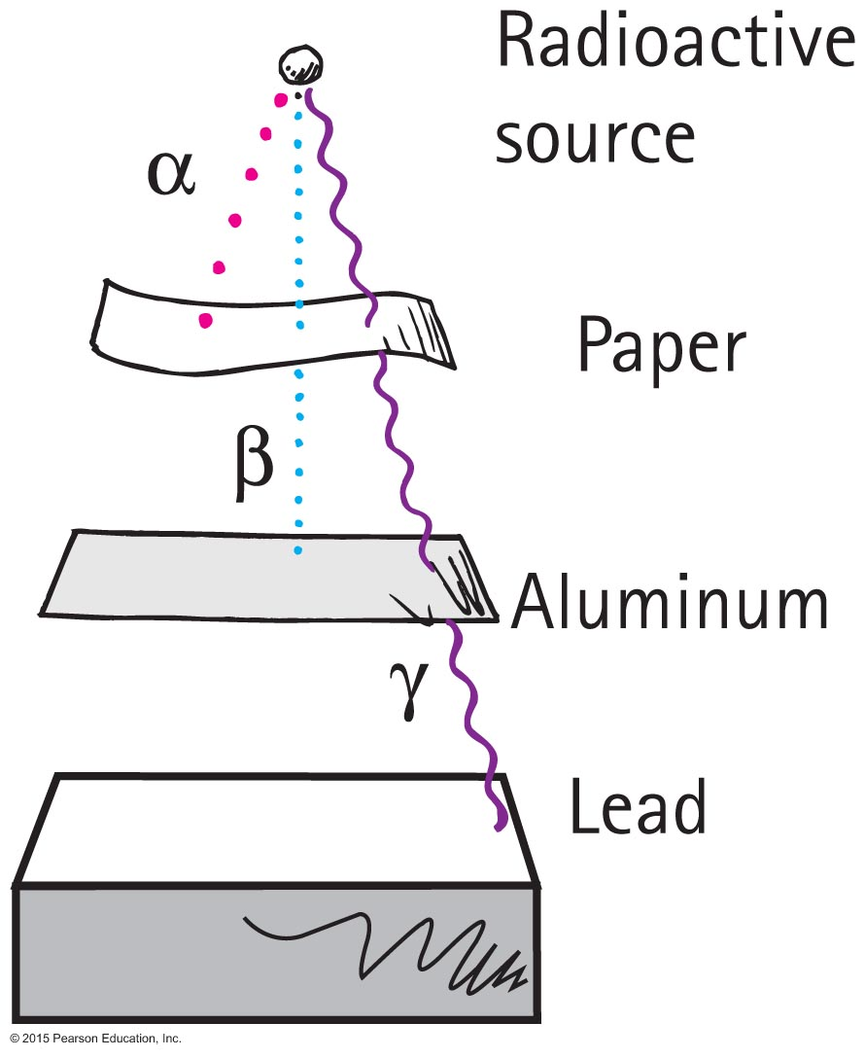
Alpha, Beta, and Gamma Rays
Relative penetrations

Slide 4
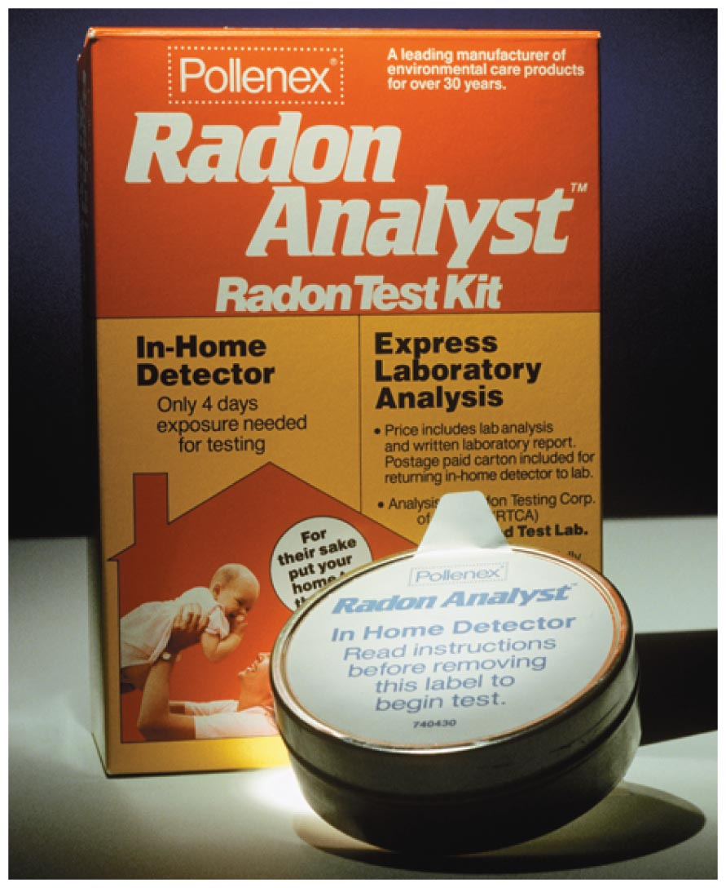
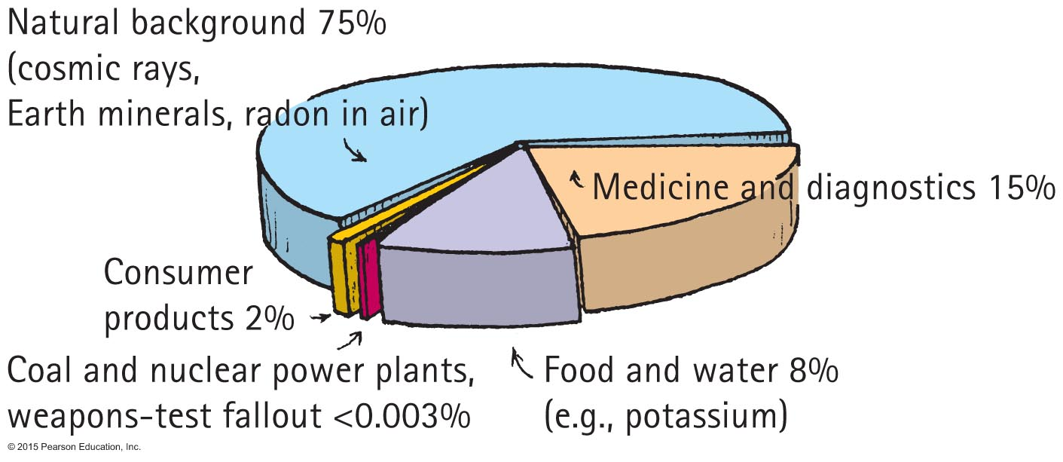
Environmental Radiation
Radon, a common environmental hazard. It is an inert gas from uranium deposits
Most radiation from natural background
About 1/5 from nonnatural sources

Slide 5
Environmental Radiation
Source received annually Typical dose (mrem=1/1000th of 1 rem)
Natural origin
Cosmic radiation 26
Ground 33
Air (Radon-222) 198
Human tissues (K-40; Ra-226) 35

Slide 6
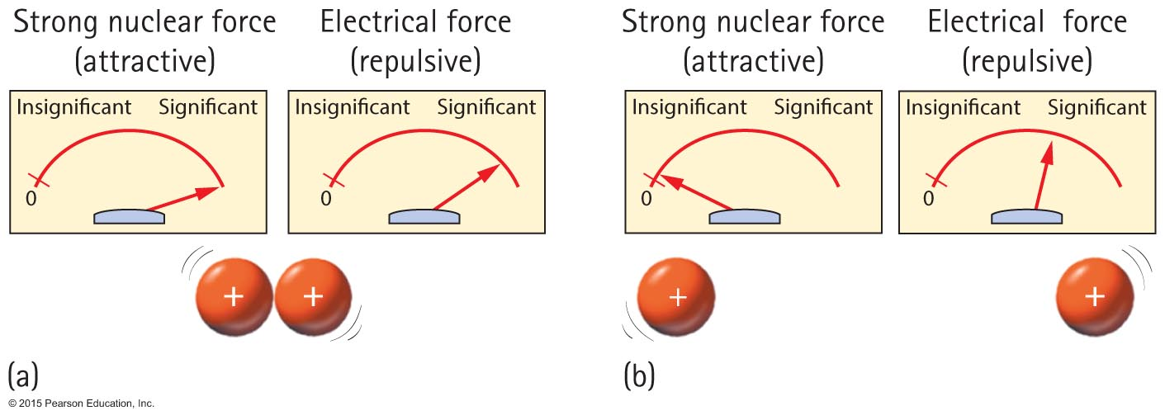
The Atomic Nucleus and the Strong Force
The strong force holds nucleons together.

Slide 7
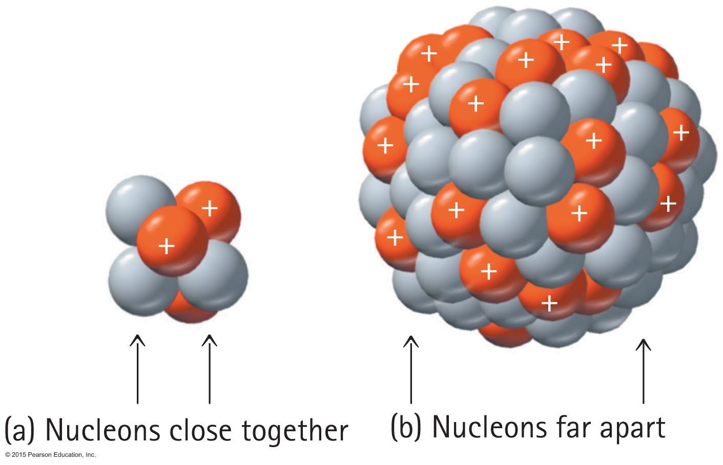
The Atomic Nucleus and the Strong Force
The strong force is more effective with smaller nuclei. Large nuclei are easier to decay

Slide 8
The Atomic Nucleus and the Strong Force
For large nuclei, more neutrons that protons are needed to compensate the electromagnetic repulsion of protons
Neutrons are the “cement” of atomic nuclei that bonds nucleons together

Slide 9
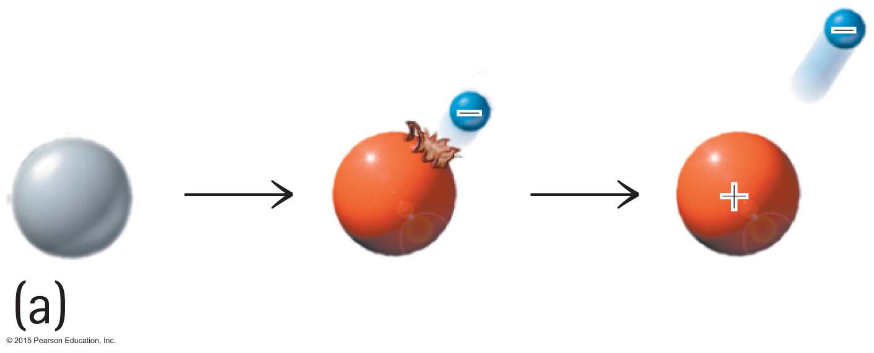
The Atomic Nucleus and the Strong Force
A lone neutron is radioactive and spontaneously transforms to a proton and an electron.
A neutron needs protons around to keep this from happening.

Slide 10
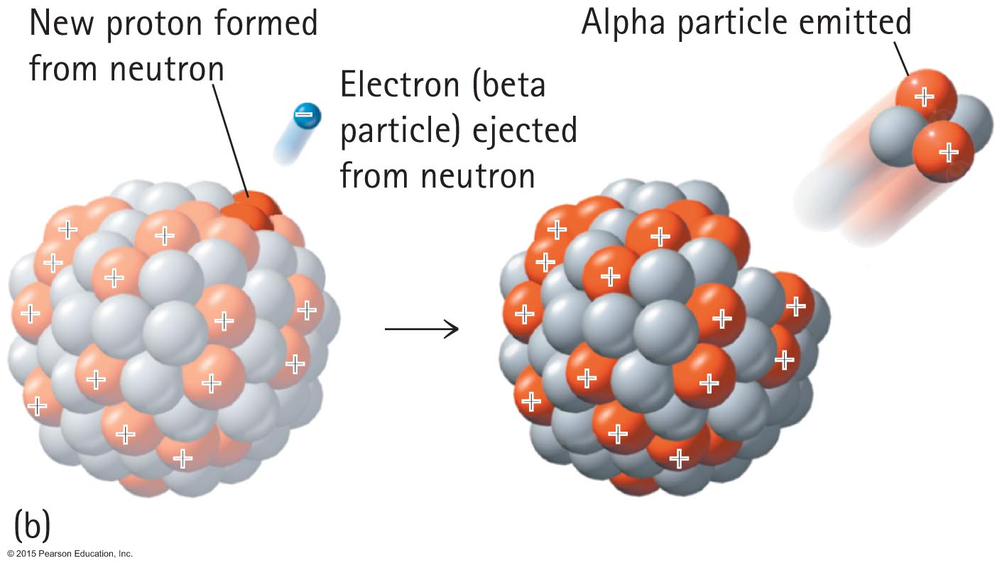
The Atomic Nucleus and the Strong Force
Alpha emission

Slide 11
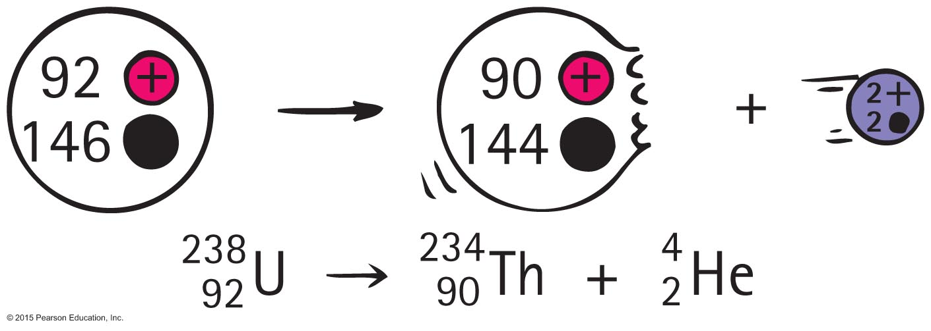
Transmutation of the Elements
With alpha or beta particle, a different element is formed. This is transmutation, which occurs in natural events and is also initiated artificially in the laboratory.
Uranium naturally transmutes to thorium when an alpha particle is emitted. Energy is released

Slide 12
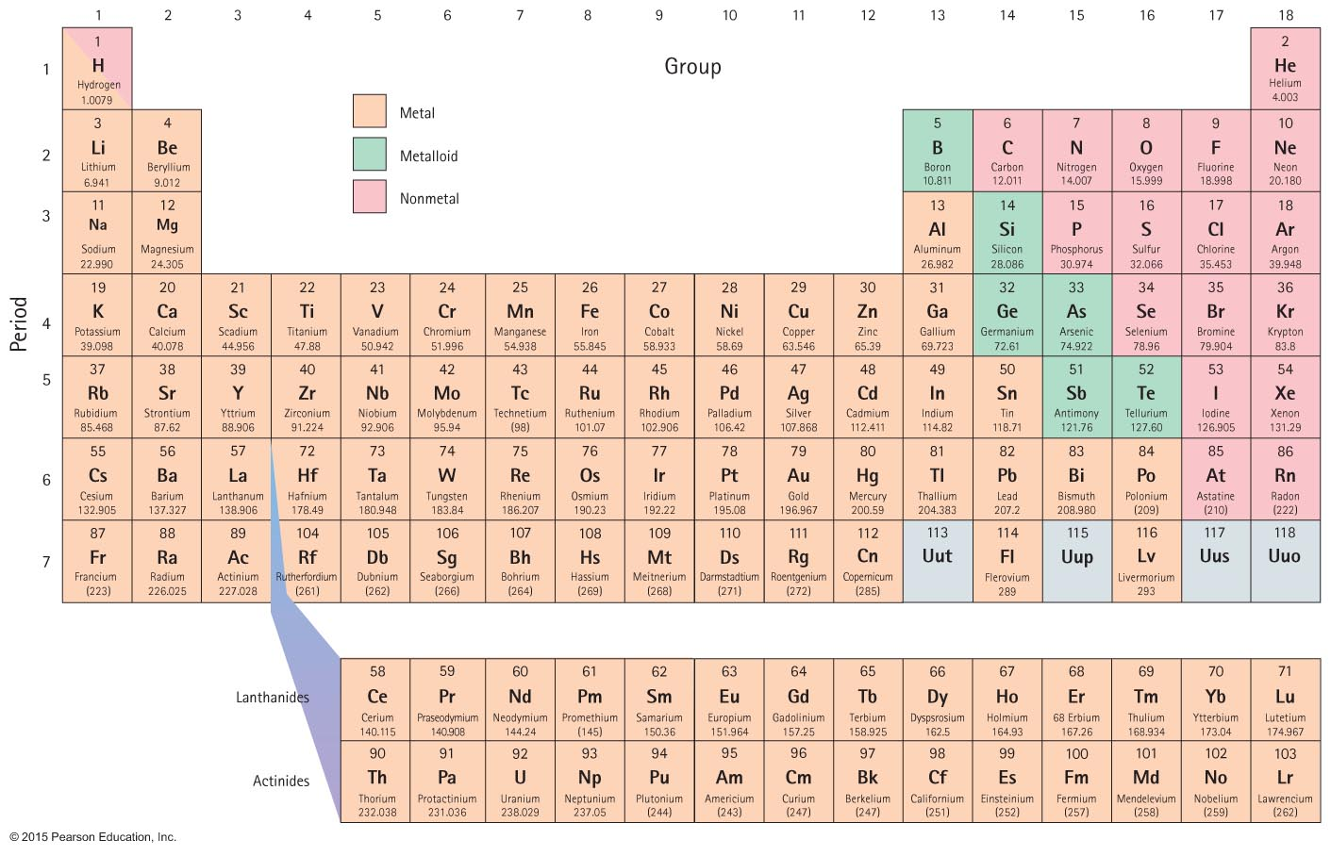
Periodic Table of the Elements
Atomic number – 4 protons
Atomic mass – 9.012 = 4 protons + 5 neutrons

Slide 13
Transmutation of the Elements
With alpha or beta particle, a different element is formed. This is transmutation, which occurs in natural events and is also initiated artificially in the laboratory.
Uranium naturally transmutes to thorium when an alpha particle is emitted. Energy is released
Atomic numbers balance: 92=90+2

Slide 14
Transmutation of the Elements
With alpha or beta particle, a different element is formed. This is transmutation, which occurs in natural events and is also initiated artificially in the laboratory.
Uranium naturally transmutes to thorium when an alpha particle is emitted. Energy is released
Mass numbers balance: 146=144+2

Slide 15
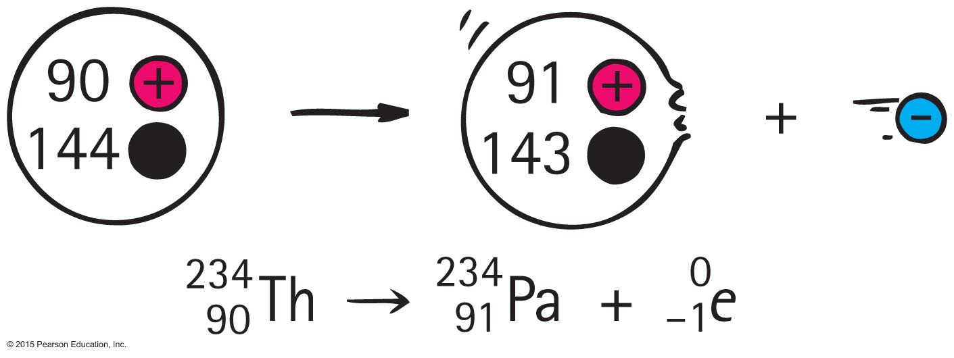
Transmutation of the Elements
Natural transmutation
Thorium naturally transmutes to protactinium when a beta particle is emitted.
An electron is e.
Superscript 0 indicates electron's mass is insignificant compared with nucleons.
Subscript –1 is the electric charge of the electron.

Slide 16
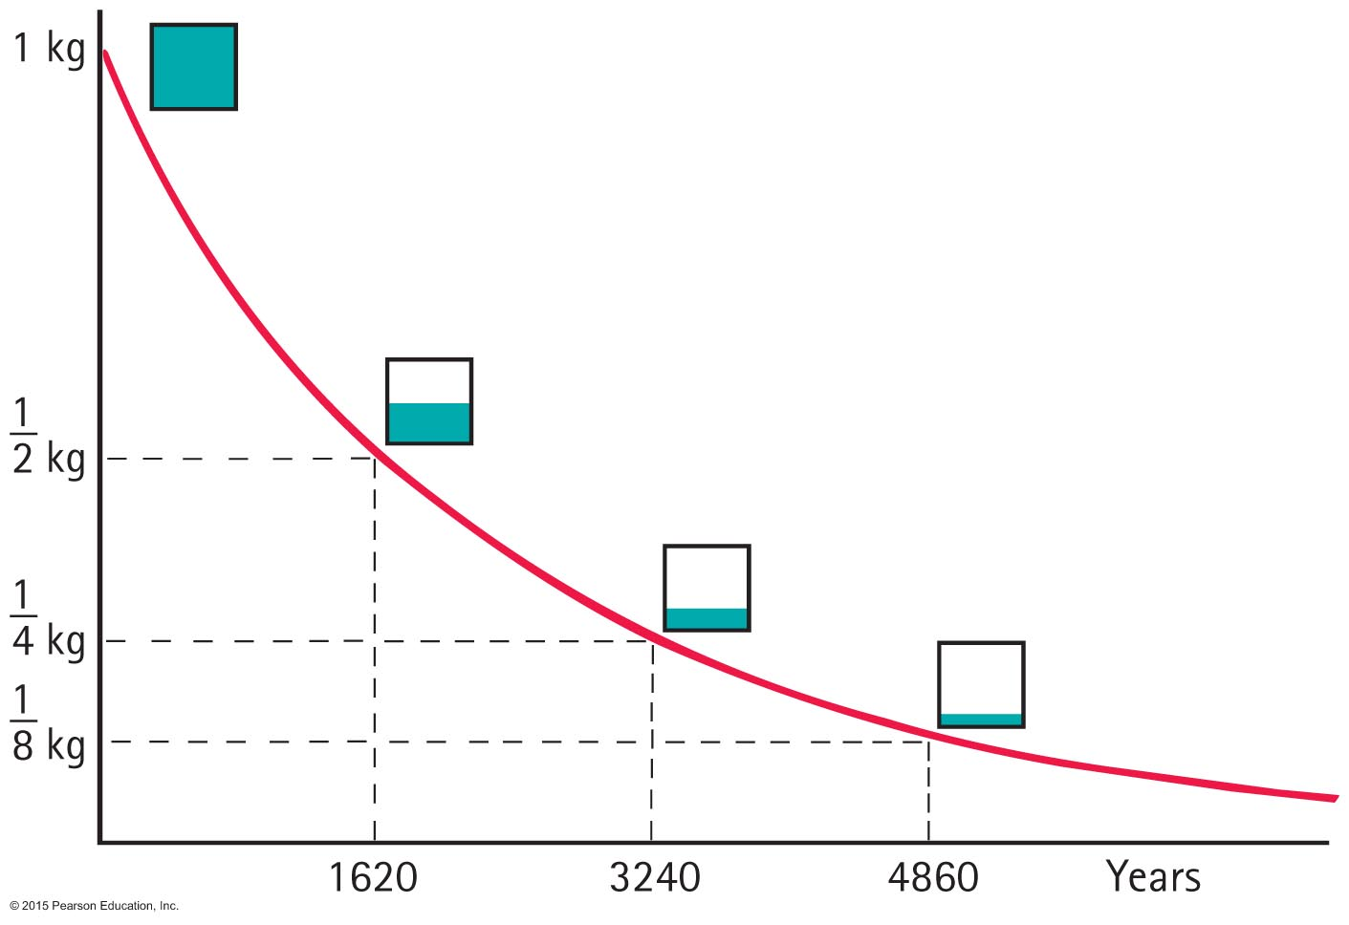
Radioactive Half-Life
The rate of decay for a radioactive isotope is measured in terms of a characteristic time, the half-life, the time for half of an original quantity of an element to decay.
Radium-226 has half life of
1620 years

Slide 17
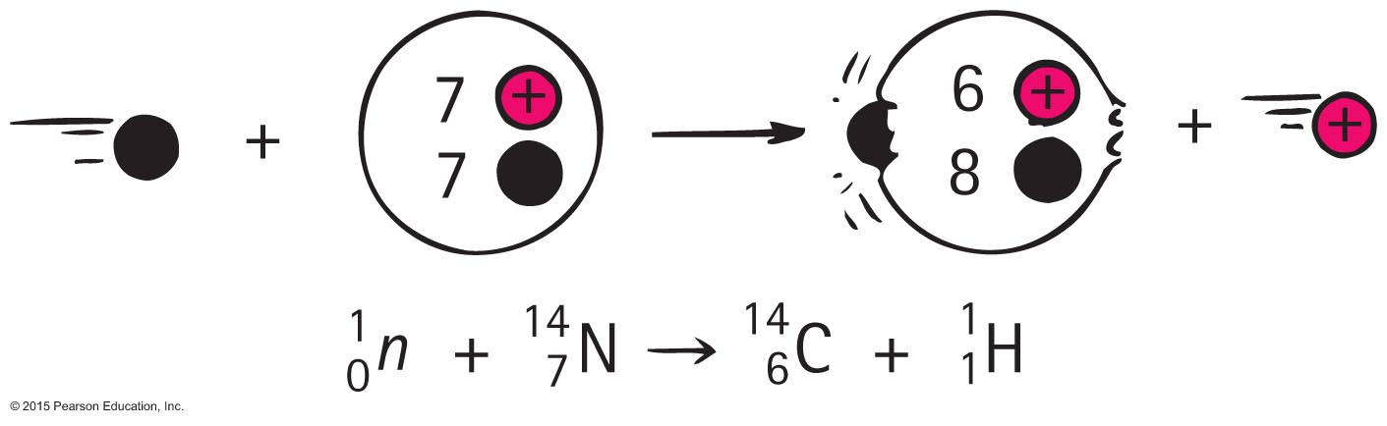
Radiometric Dating
Earth's atmosphere is continuously bombarded by cosmic rays, which causes many atoms in the upper atmosphere to transmute. These transmutations result in many protons and neutrons.
A nitrogen that captures a neutron and becomes an isotope of carbon by emitting a proton:

Slide 18
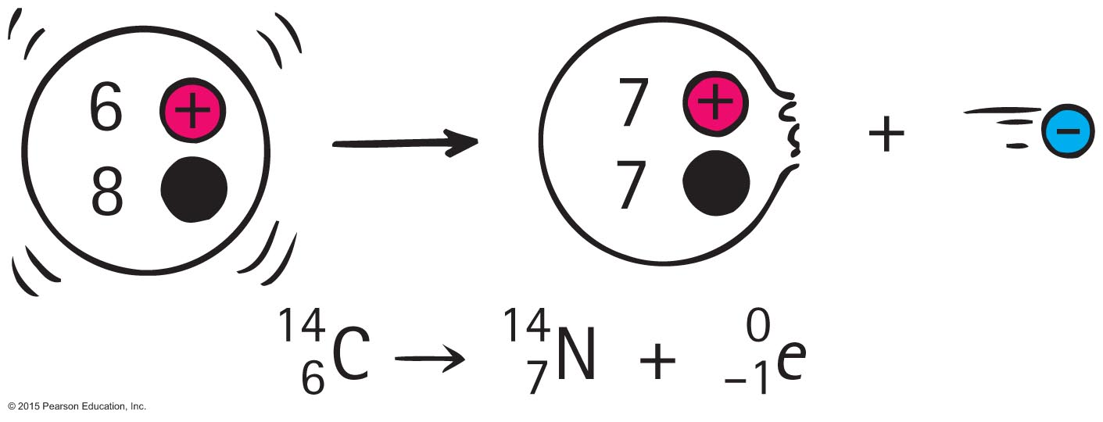
Radiometric Dating
Carbon-14 is a beta emitter and decays back to nitrogen.
Half life 5730 years
Because living plants take in carbon dioxide, any C-14 lost by decay is immediately replenished with fresh C-14 from the atmosphere.
Dead plants continue emitting C-14 without replenishment.

Slide 19
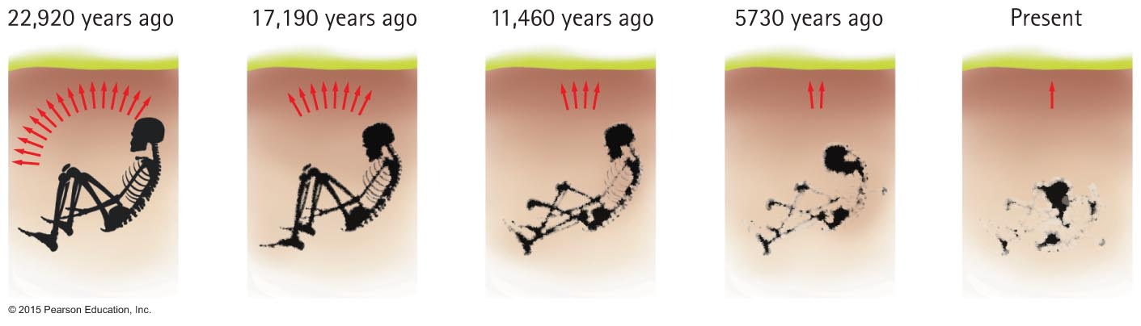
Radiometric Dating
Relative amounts of C-12 to C-14 enable dating of organic materials. Half life 5730 years
1/1
1/2
1/4
1/8
1/16

Slide 20
Nuclear Fission and Fusion

Slide 21
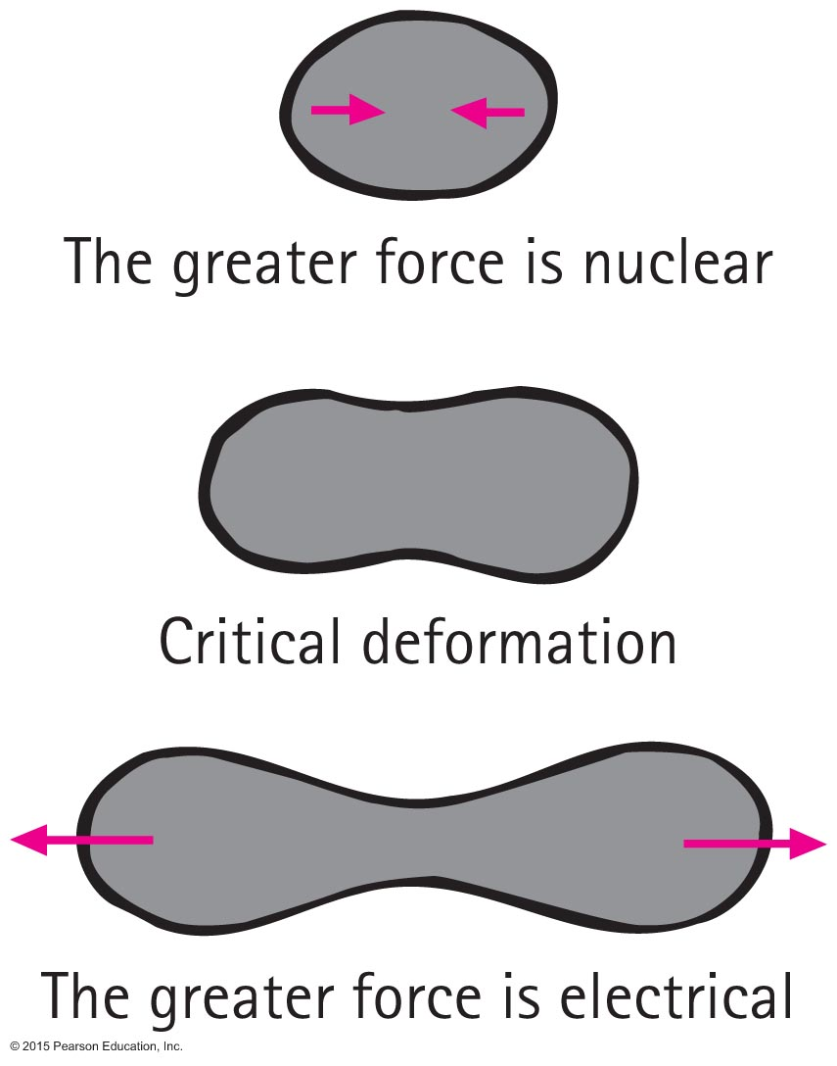
Nuclear Fission
German scientists Otto Hahn and Fritz Strassmann in 1938 accidentally discovered nuclear fission.
Lise Meitner and Otto Frisch explained the process and gave it the name nuclear fission.

Slide 22
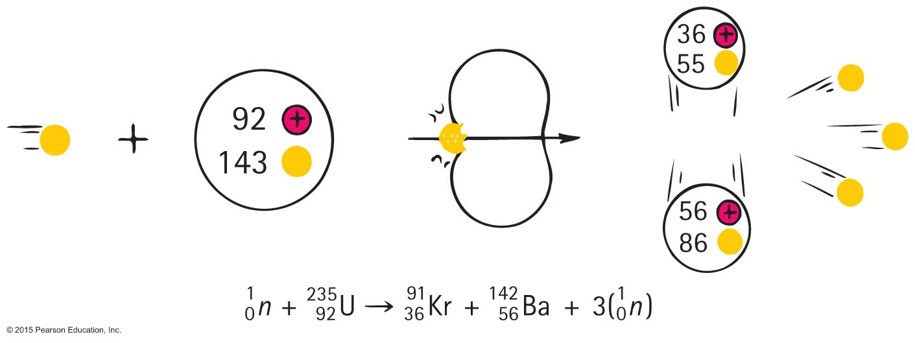
Nuclear Fission
A typical uranium fission reaction:
Neutron + Uranium -> Krypton + Barium + 3 Neutrons
Note the mass number as well as atomic numbers balance.

Slide 23
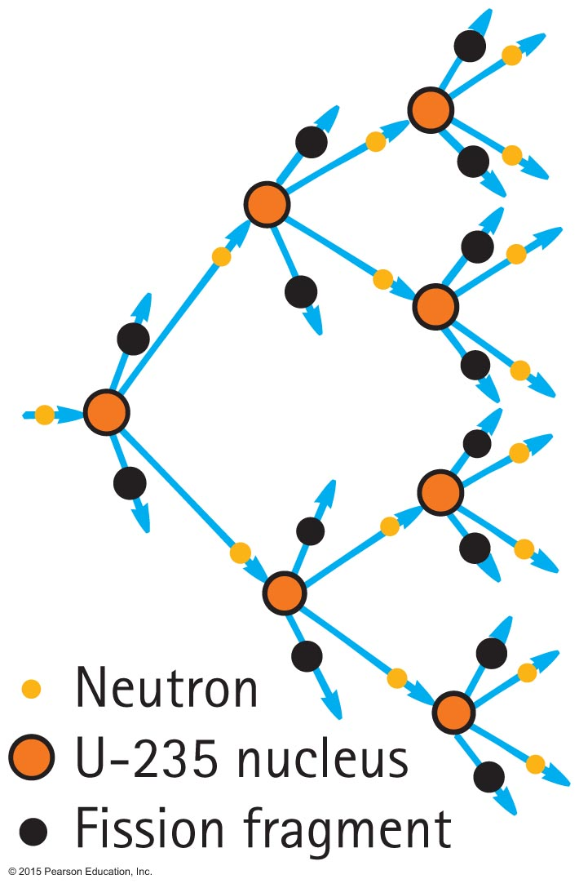
Nuclear Fission
Chain reaction—a self-sustaining reaction in which the products of one reaction event stimulate further reaction events

Slide 24
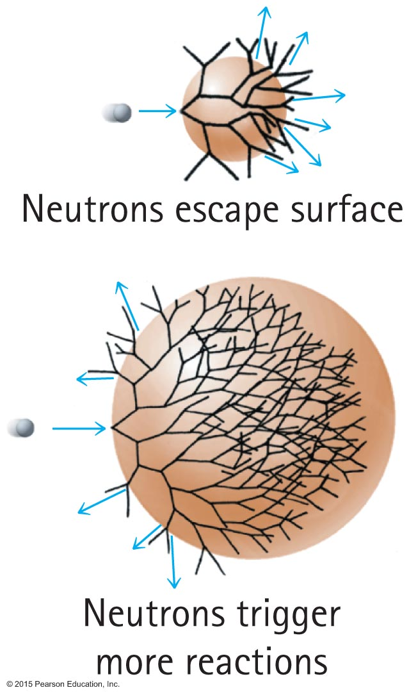
Nuclear Fission
Chain reaction in uranium
Small amount: more surface, chain reaction stops.
Critical amount : less surface to escape, chain reaction produces an explosion. Heat is produced by kinetic energy of fragments

Slide 25
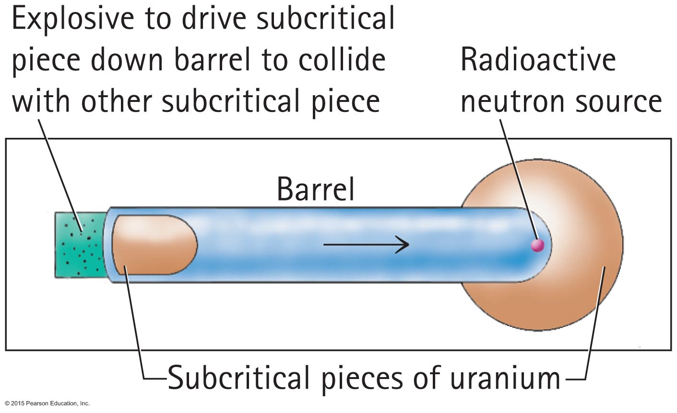
Nuclear Fission
Fission bomb
A bomb in which pieces of uranium are driven together is a so-called "gun-type" weapon.
Constructing a fission bomb is a formidable task. The difficulty is separating enough U-235 fuel.

Slide 26
Nuclear Fission
Why all Uranium on the Earth does not explode?
Only 0.7% is U-235 while the rest is U-238 which does not ordinary have chain reaction
U-235 fuel is difficult to separate.

Slide 27
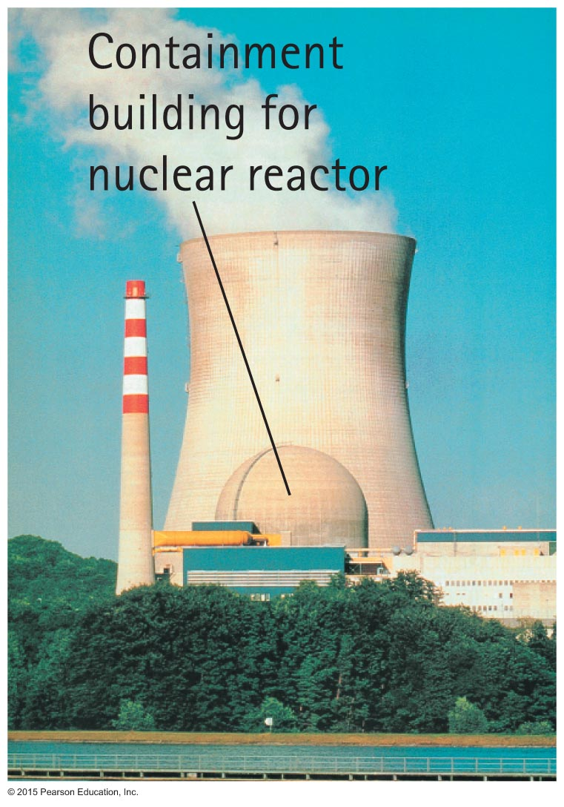
Nuclear Fission Reactors
Nuclear fission reactors
About 20% of electric energy in the United States is generated by nuclear fission reactors.
More in some other countries—about 75% in France.
Reactors are simply nuclear furnaces that boil water to operate steam-driven generators.

Slide 28
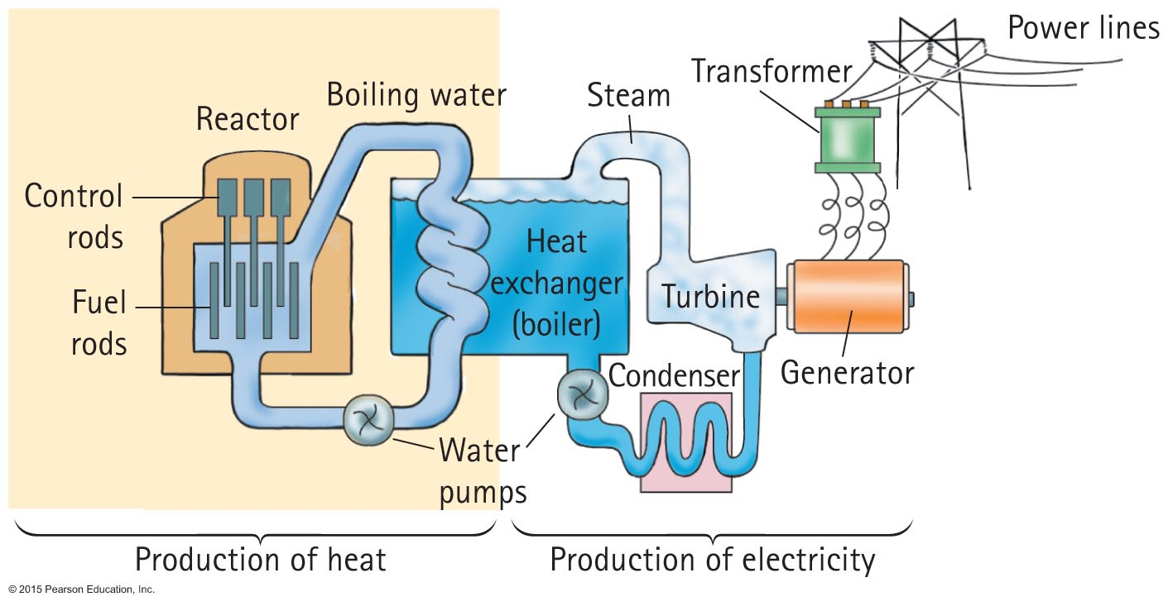
Nuclear Fission Reactors
Diagram of a typical power plant:

Slide 29
Nuclear Fission Reactors
Today's fission reactors contain three components:
The nuclear fuel is primarily U-238 plus about 3% U-235.
The control rods are made of a neutron-absorbing material, usually cadmium or boron.
Water surrounding the nuclear fuel is kept under high pressure to keep it at a high temperature without boiling.

Slide 30
Fission Power
The benefits are plentiful electricity, conservation of billions of tons of fossil fuels every year that are converted to heat and smoke (which in the long run may be far more precious as sources of organic molecules than as sources of heat), and the elimination of megatons of carbon dioxide, sulfur oxides, and other deleterious substances put into the air each year by the burning of fossil fuels.
Remember that coal plants release more radioactivity compared to nuclear plants!

Slide 31
Fission Power
The chain reaction explosion cannot occur in fission reactors, however there’s danger of generating enough heat to melt down the reactor itself (Chernobil 1986, Fukushima, 2012) that can lead to a leak of radioactive material. There is risks of release of radioactive isotopes into the atmosphere, by accident or by terrorist activities. Radioactive waste disposal is a problem (although not for some countries that monitor it for potential use later).

Slide 32
Fission Power
Why fission even produces energy?
Remember that the energy and the mass are related
E = mc²
^{So what is the mass?}

Slide 33

Mass–Energy Equivalence—E = mc²
Early in the early 1900s, Albert Einstein discovered that mass is actually "congealed" energy.
Enormous work is required to pull nucleons from a nucleus. This work is energy added to the nucleon that is pulled out.
It means that free nucleon is more massive than a nucleon inside of a nucleus!

Slide 34
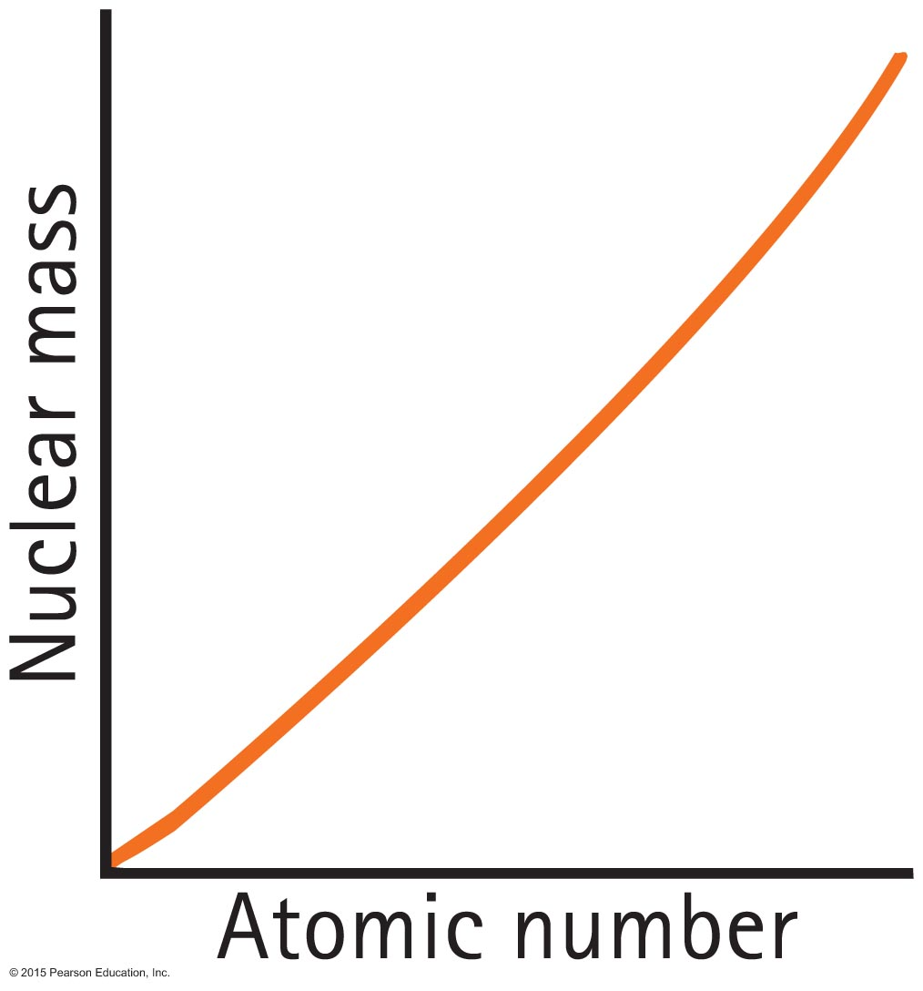
Mass–Energy Equivalence—E = mc²
The plot shows how nuclear mass increases with increasing atomic number.

Slide 35
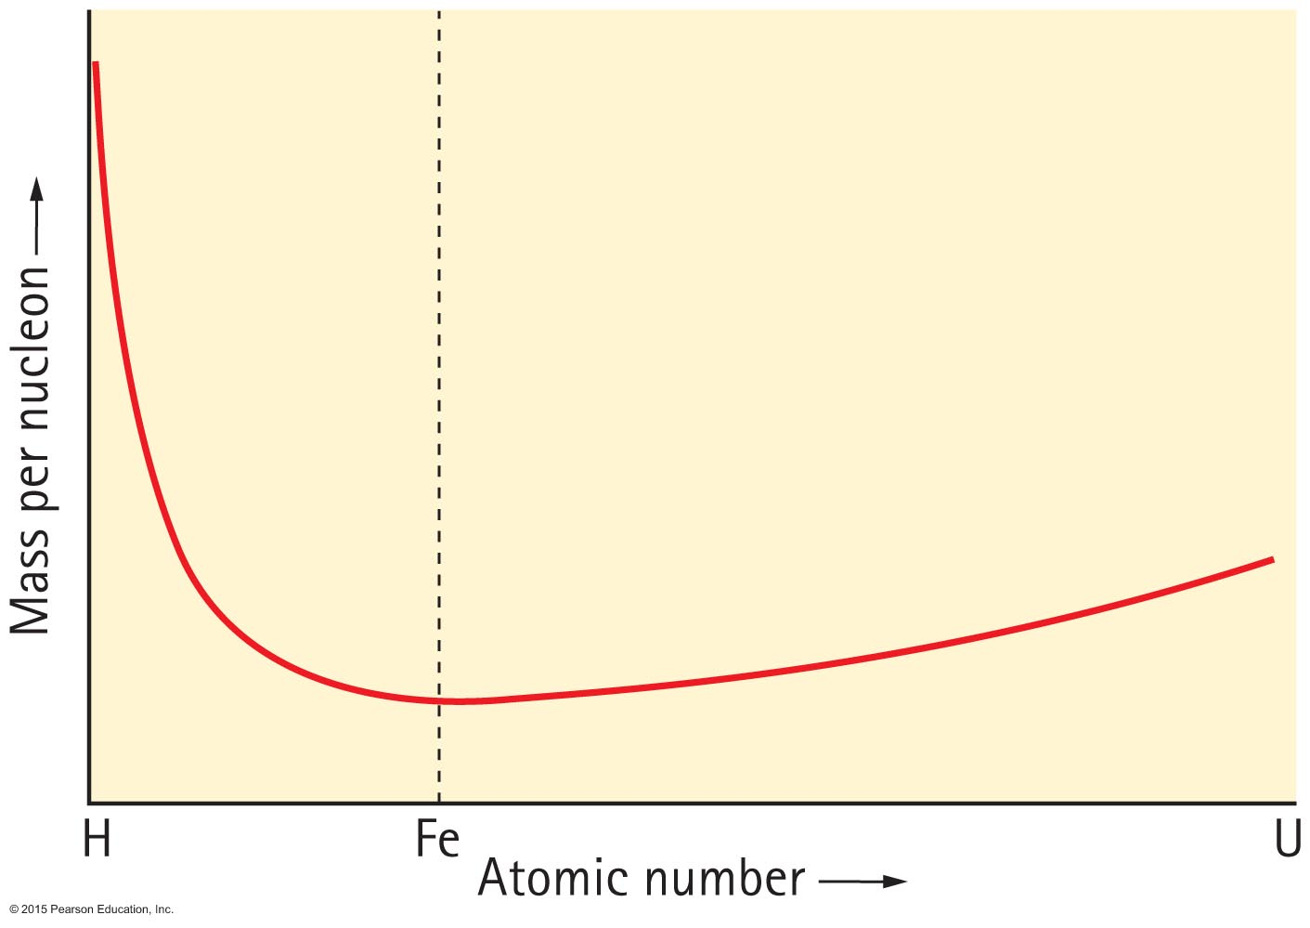
Mass–Energy Equivalence—E = mc²
A very important graph results from the plot of nuclear mass per nucleon from hydrogen through uranium.

Slide 36
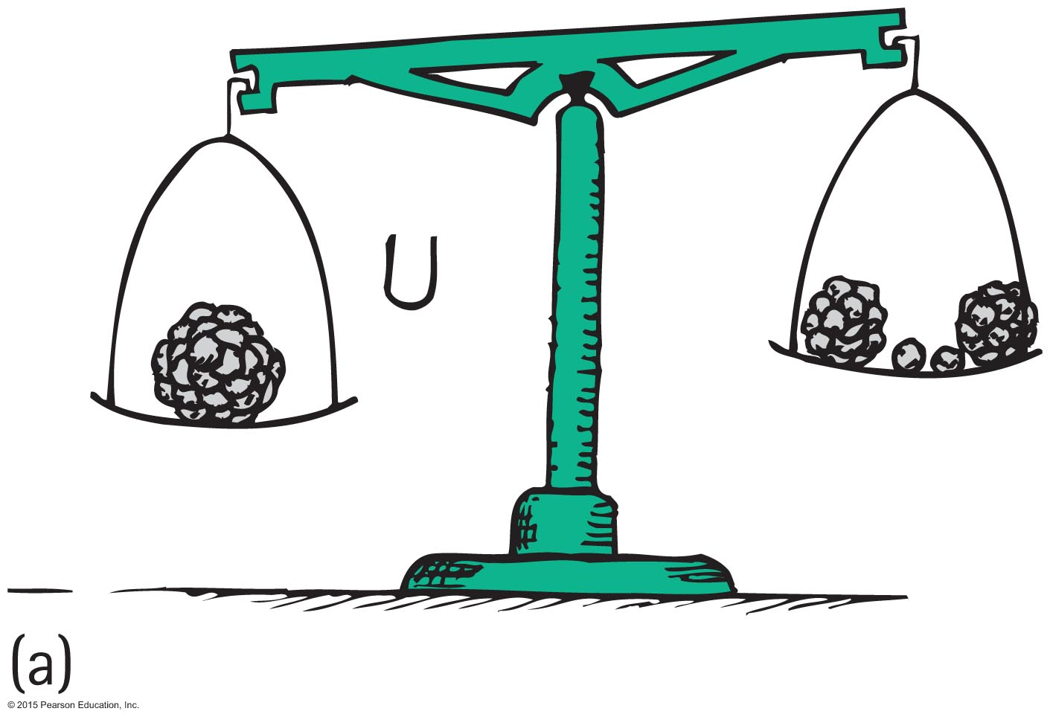
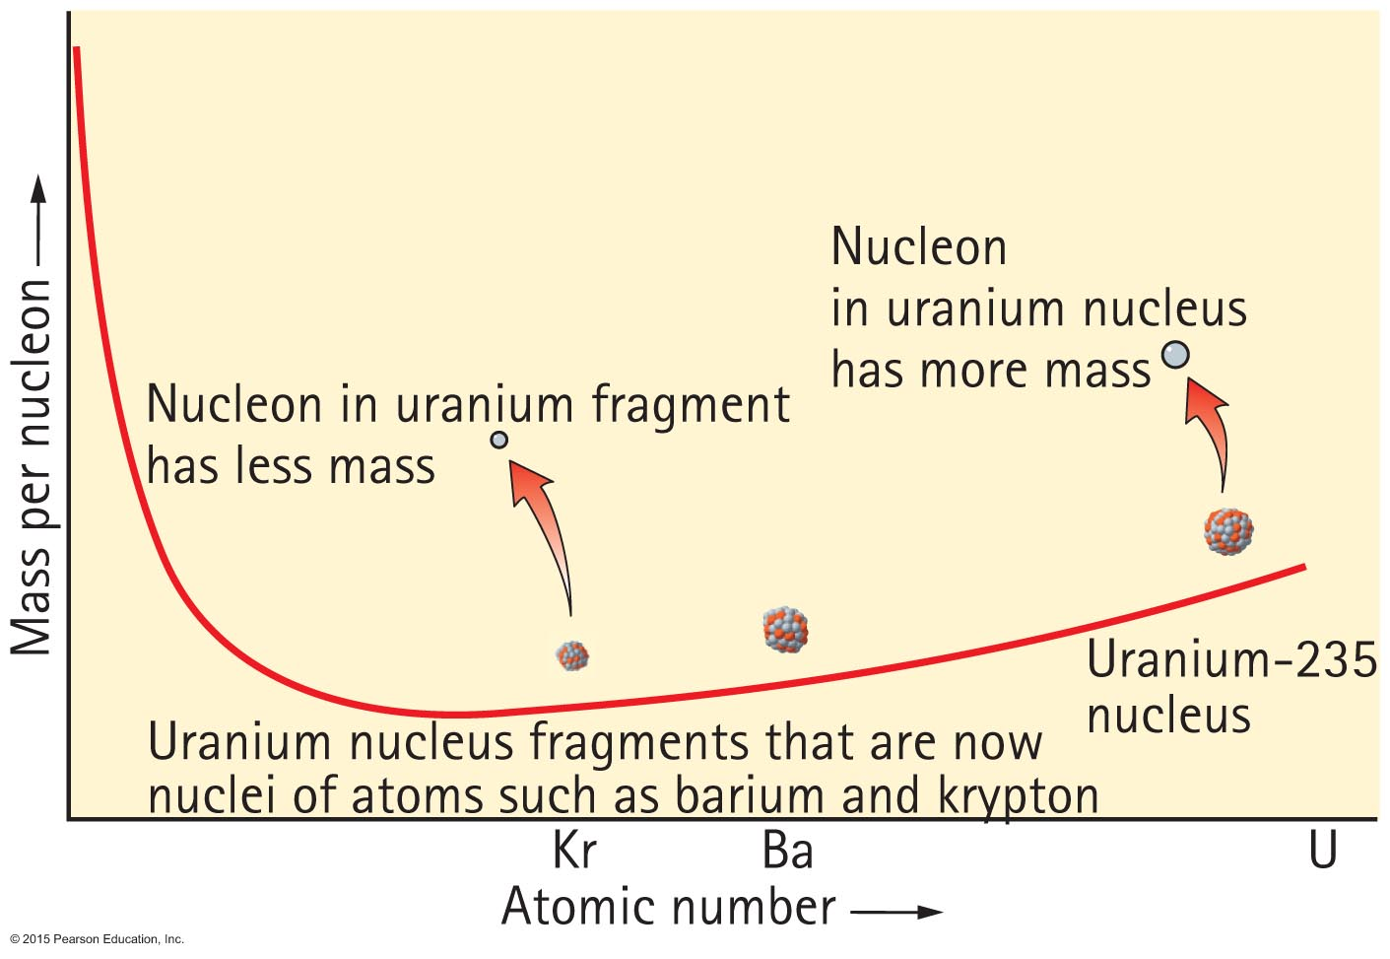
Mass–Energy Equivalence—E = mc²
The same graph, with emphasis on nuclear fission:
The difference in
Mass = energy released

Slide 37
Notes:
Figure 34.18a

Slide 38
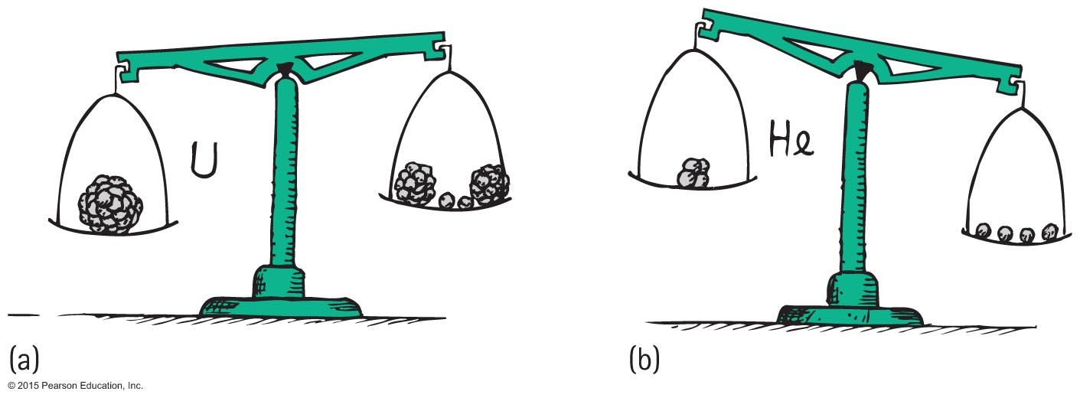
Nuclear Fusion
Nuclear fusion is the opposite of nuclear fission.
Fission: nuclei "fizz" apart.
Fusion: nuclei fuse together.
Each releases energy

Slide 39
Nuclear Fusion: How stars produce energy
Inside of stars the temperature is so great that atoms of hydrogen start fusing together producing atoms of helium. This fusion is called thermonuclear fusion
This fusion releases a lot of energy. Most energy is kinetic energy od fragments and once fragments are stopped, this energy is turned into the heat.
Every second 657 million tons of hydrogen is fused into 653 million tons of helium in the Sun.
The “missing” 4 million tons of mass convert into energy

Slide 40
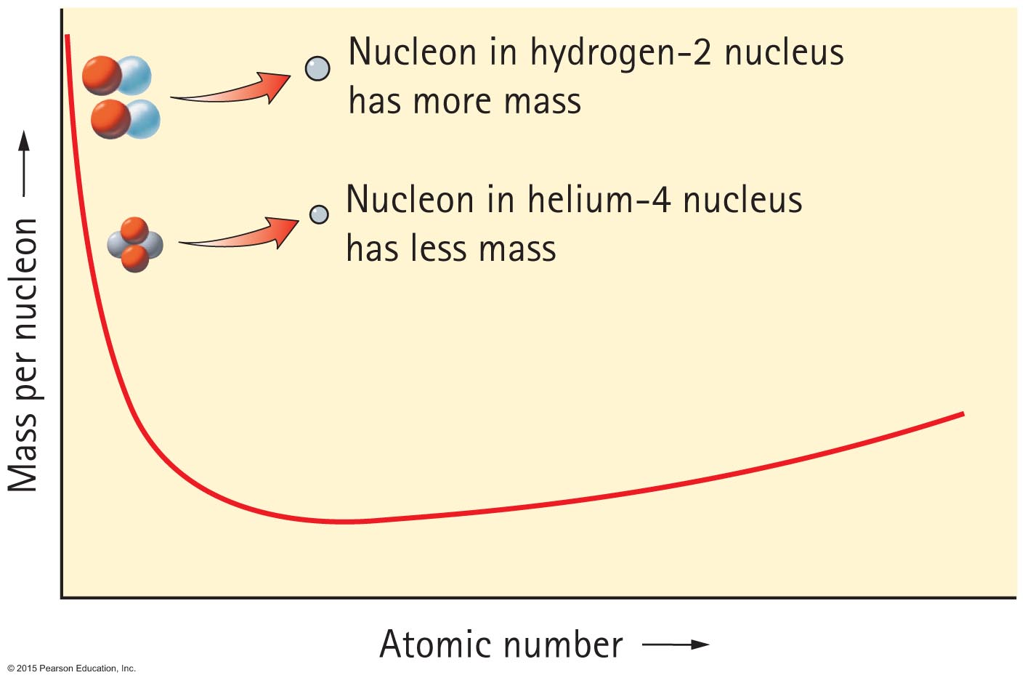
Nuclear Fusion

Slide 41
Nuclear Fusion
Fission and fusion compared
7 times as much energy per nucleon can be produced in fusion compared to fission.

Slide 42
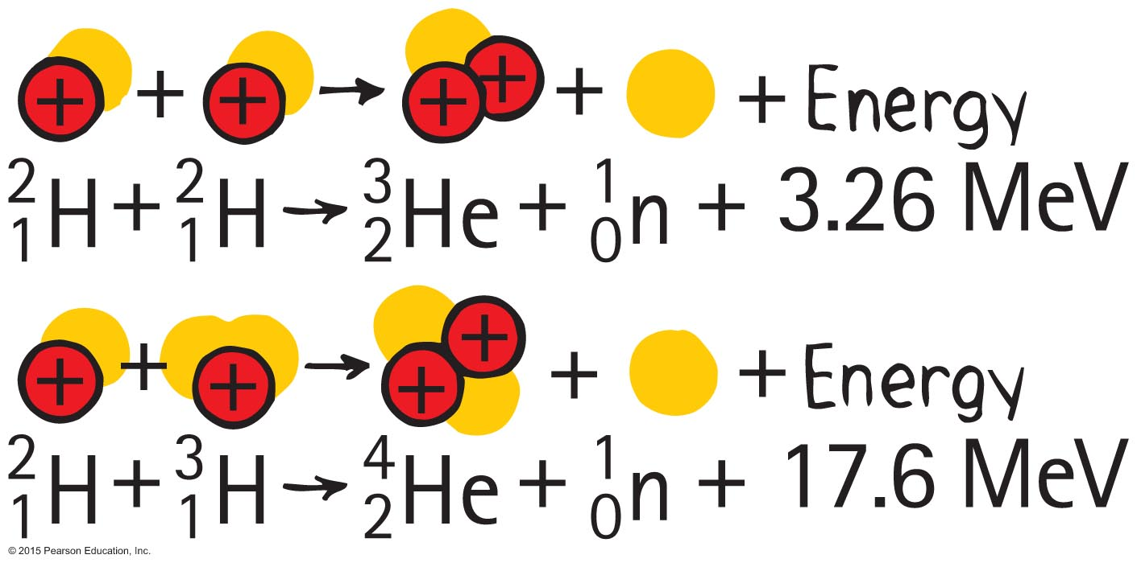
Nuclear Fusion
Typical fusion reactions:

Slide 43
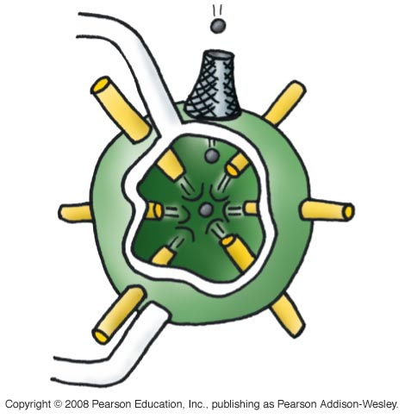
Controlling Fusion
Carrying out fusion is more difficult than thought when fission succeeded.
Plasma reactors have not been successful.
Other schemes, including lasers, are being considered.
Deuterium pellets rhythmically dropped into synchronized laser crossfire; heat used to produce steam:

